Slide 1
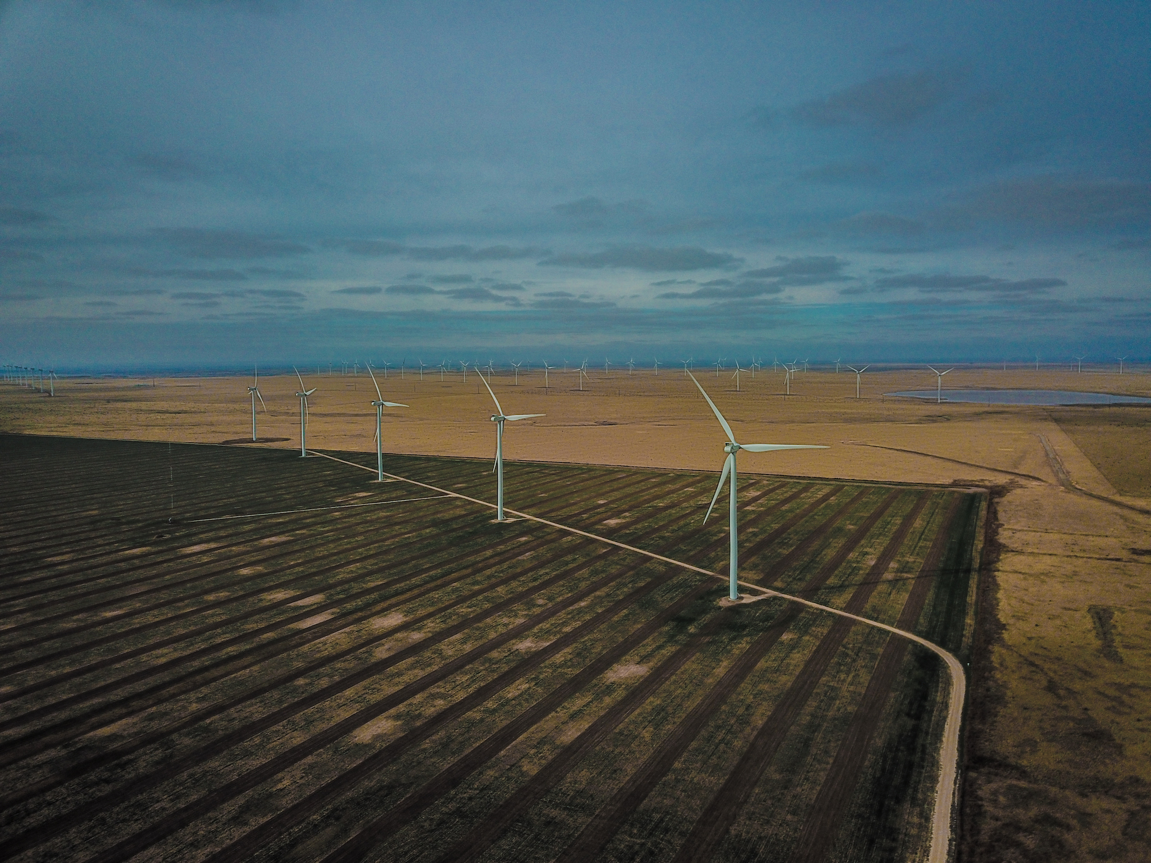
Development, from Above & Beyond
___
a photography project by Borja Santos & Simon Black

Slide 2
Description
Our world is changing, for better and for worse.
Your organization wants to make it better, but this can be hard to communicate.
Photography is a powerful tool, connecting with people like no other medium.
We are two development practitioners and recent Harvard graduates.
We use drones and cameras to connect you to your audience in visual and visceral way. Your development story is important. We want to help you tell it.

Slide 3
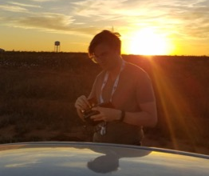
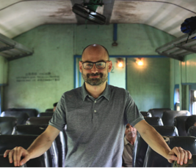
Who we are
Simon Black is from the UK and is currently based in New York. He loves travelling and taking photos from the air, land, and sea to show how our world is changing. His work can be seen here.
Simon recently graduated with an MPA in International Development (MPA/ID) from Harvard. He currently works for the World Bank, helping developing countries mitigate and adapt to climate change through economic reform. He has also worked as a macroeconomist for the British government, a financial consultant to banks in London, and as a microfinance consultant in Bangladesh and the Philippines.
Borja Santos is from Spain and has ten years of development experience. He also works as a photojournalist, telling stories about important social issues. His work can be seen here.
Borja also recently graduated with an MPA/ID from Harvard. He is currently a consultant and adjunct professor of international development at IE University. He is a public policy practitioner having worked in evaluation for the World Bank in Perú, in economic growth for Harvard’s CID in Sri Lanka, in resilience and humanitarian action with the United Nations in Ethiopia and Ecuador, and in project management for the Spanish Ministry of Foreign Affairs.

Slide 4
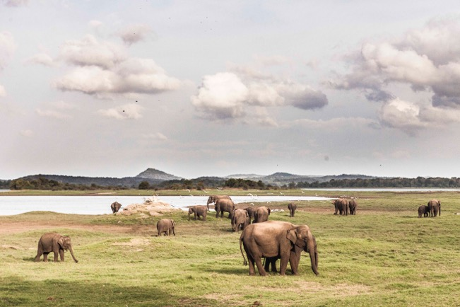
Environment

Slide 5
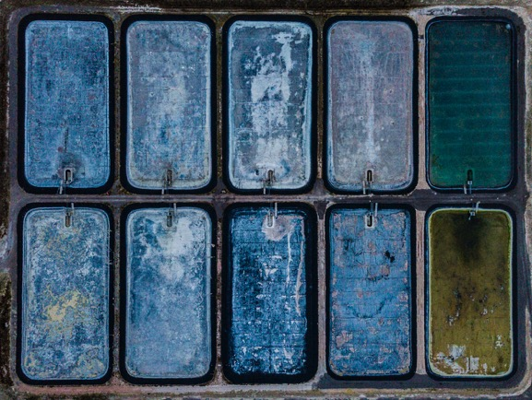
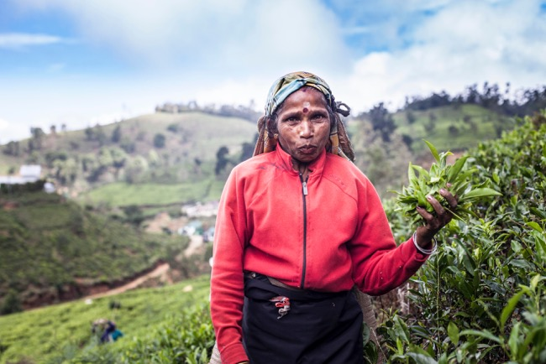
Agriculture

Slide 6
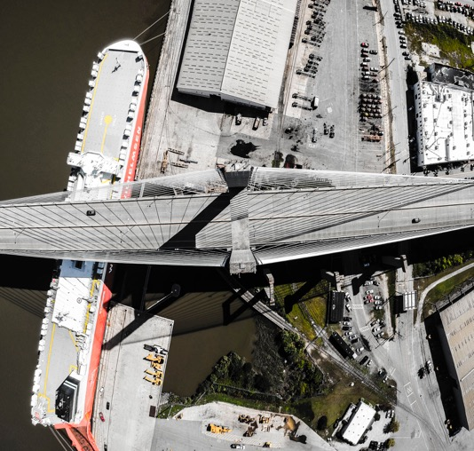

Infrastructure

Slide 7
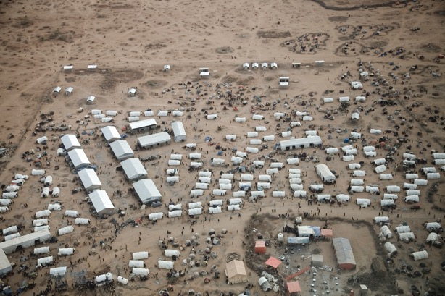
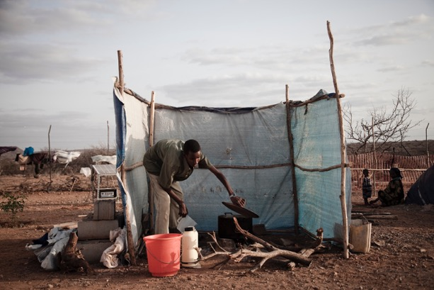
Humanitarian

Slide 8
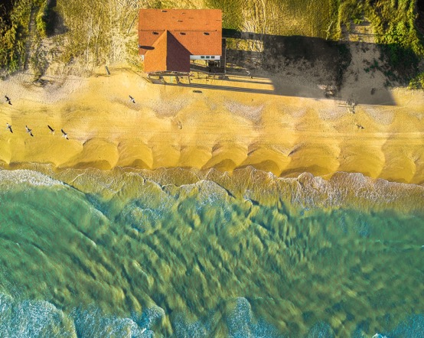
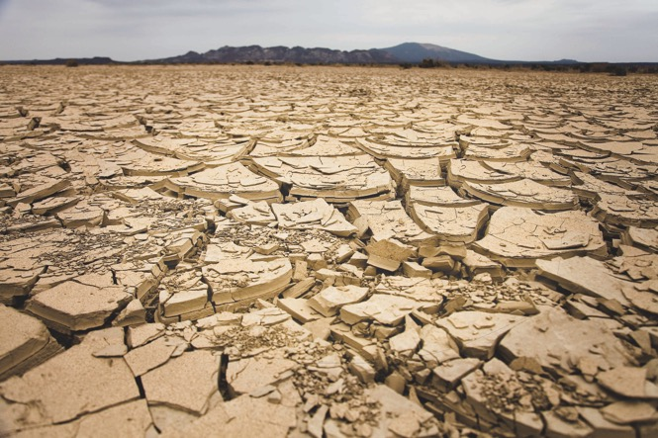
Climate change

Slide 9
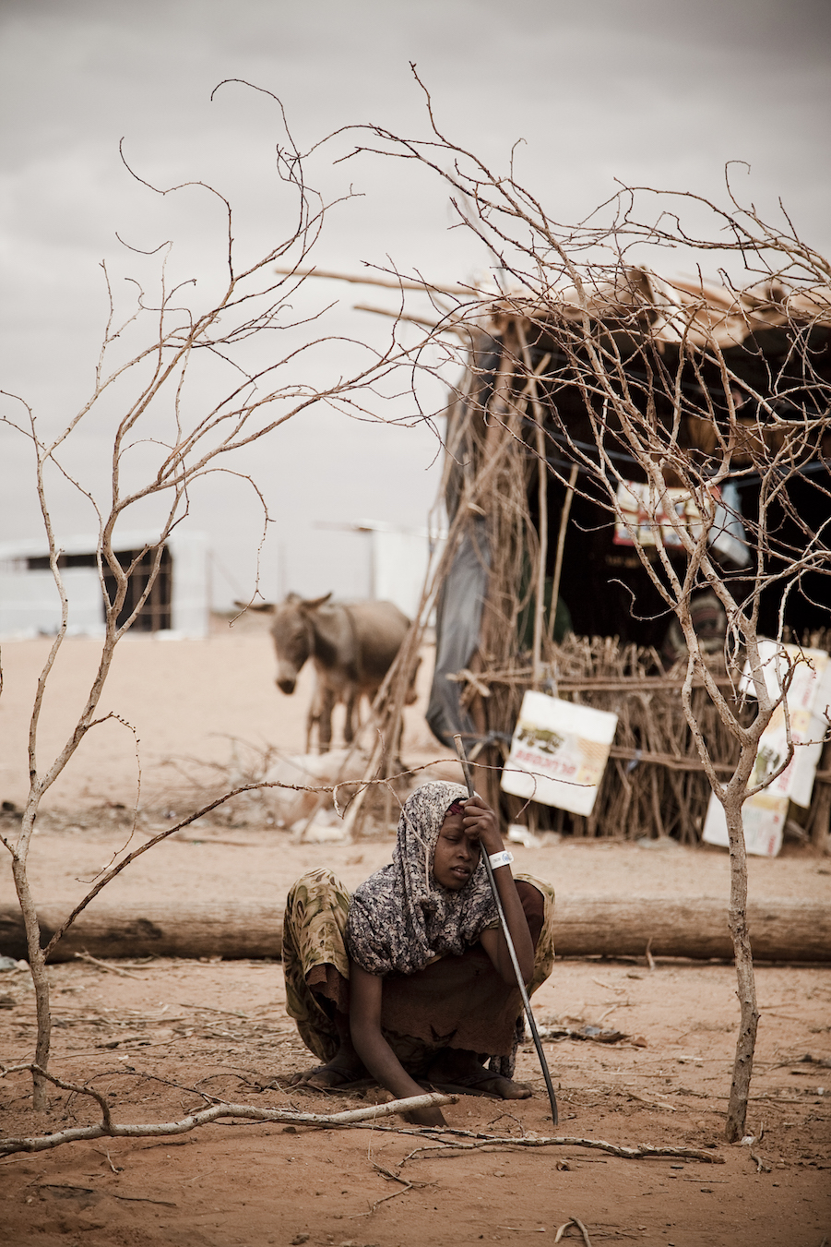
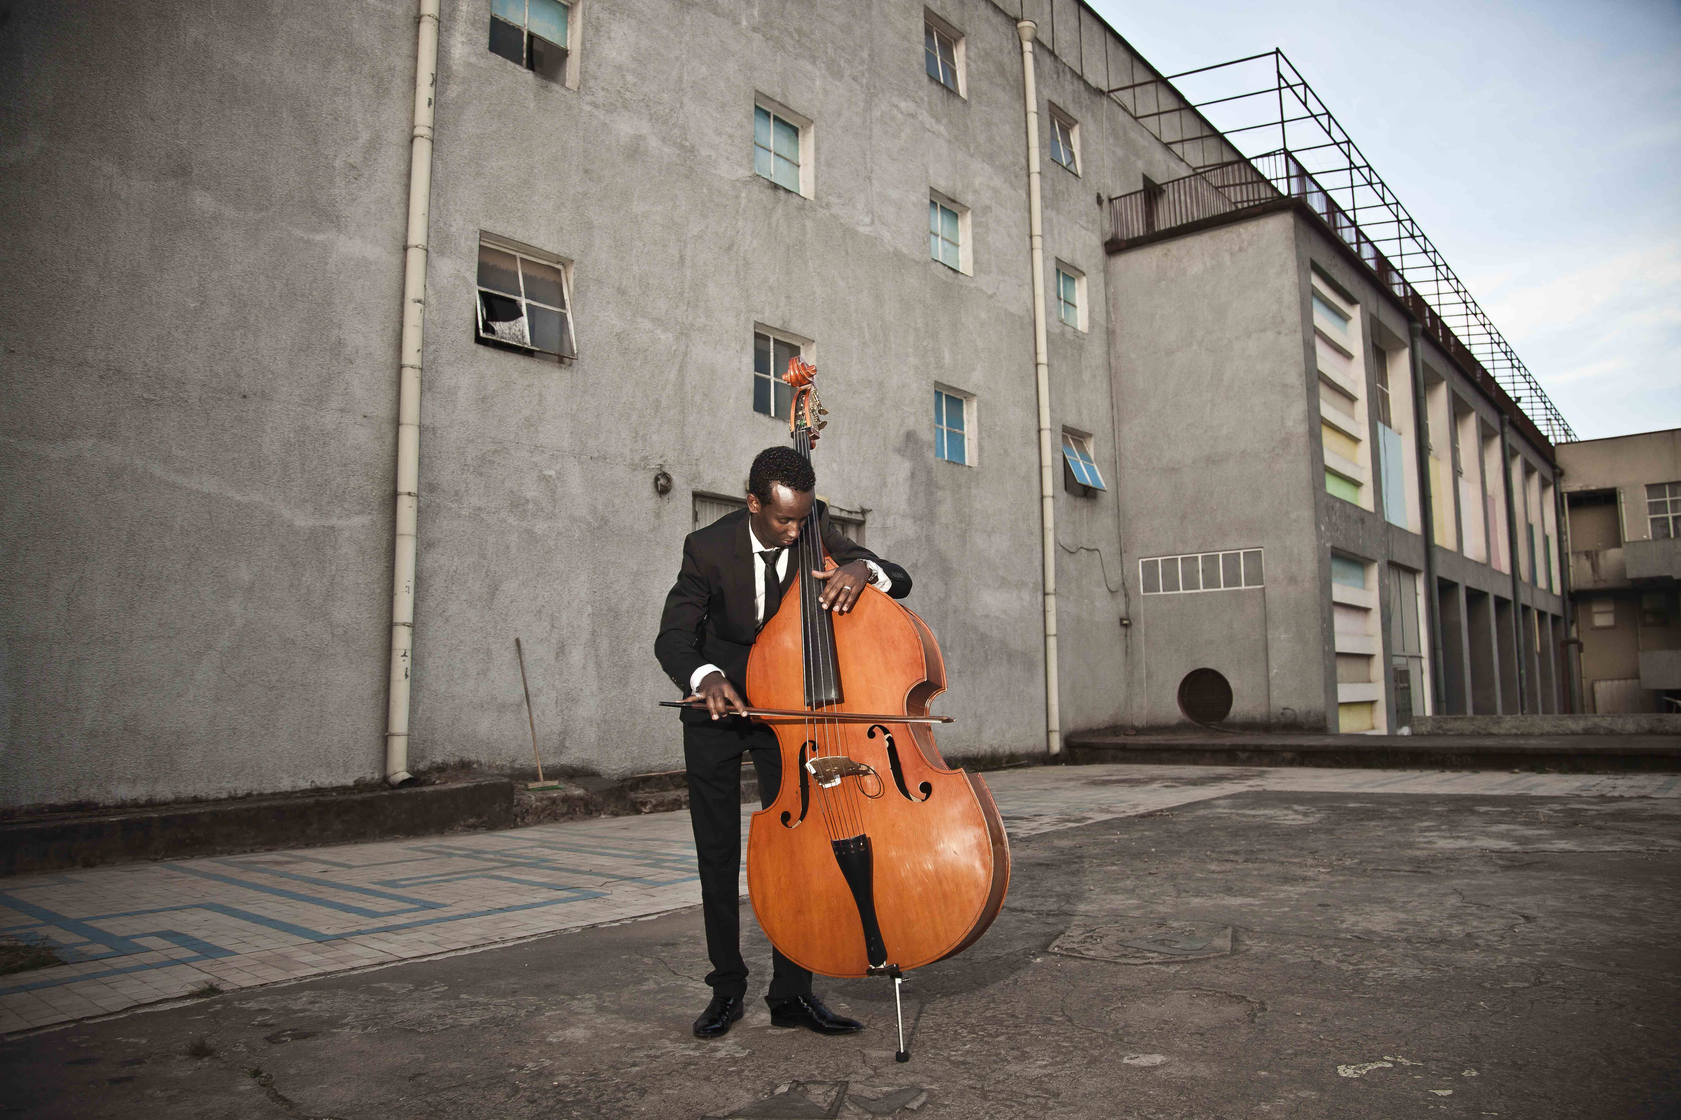
Personal stories

Slide 10
Outputs
core deliverables: 50+ photographs with captions, in agreed formats for use on websites, social media, brochures and other promotional materials a compiled photobook, or a short article telling the story in English and Spanish
additional services:
comprehensive article, focused for major media outlets, shorter blog posts, short video

Slide 11
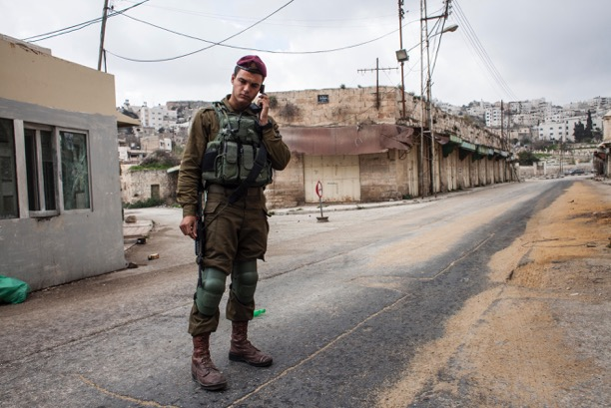
Contact us
For more information, contact us at:
info@development.photos
We look forward to speaking with you! - Borja & Simon

